Slide 1
Chapter 4 : Processes

Slide 2
Process Concept
A process is basically a program in execution. The execution of a process must progress in a sequential fashion.
A process is defined as an entity which represents the basic unit of work to be implemented in the system .
To put it in simple terms, we write our computer programs in a text file and when we execute this program, it becomes a process which performs all the tasks mentioned in the program.
Textbook uses the terms job and process almost interchangeably

Slide 3
Process Concept
Program is passive entity stored on disk (executable file), process is active
Program : a file containing a list of instructions stored on disk called executable file
Program becomes process when executable file loaded into memory, with a PC specify the next instruction to execute and a set of associated resources.
Execution of program started via GUI mouse clicks, command line entry of its name, etc
These processes can execute concurrently with the CPU ,By switching CPU b/w the processes the OS can make the computer more productive.
One program can be several processes

Slide 4
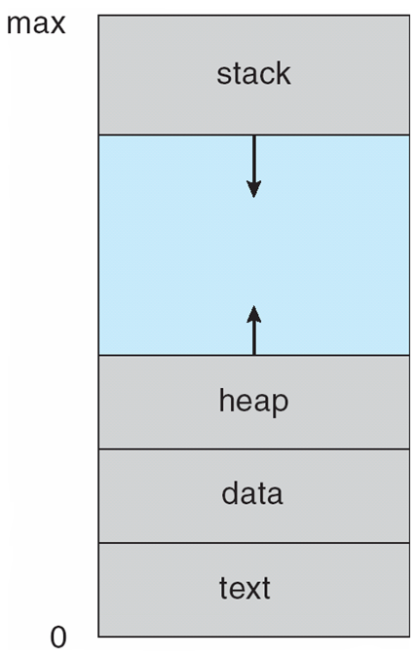
Process in Memory

Slide 5
S.N. | Component & Description
1 | Stack The process Stack contains the temporary data such as method/function parameters, return address and local variables.
2 | Heap This is dynamically allocated memory to a process during its run time.
3 | Text This includes the current activity represented by the value of Program Counter and the contents of the processor's registers.
4 | Data This section contains the global and static variables.

Slide 6
The program code, also called text section
Current activity including program counter, processor registers
Stack containing temporary data
Function parameters, return addresses, local variables
Data section containing global variables
Heap containing memory dynamically allocated during run time

Slide 7
Program
A program is a piece of code which may be a single line or millions of lines. A computer program is usually written by a computer programmer in a programming language. For example, here is a simple program written in C programming language
#include <stdio.h>
int main()
{ printf("Hello, World! \n");
return 0; }
A computer program is a collection of instructions that performs a specific task when executed by a computer. When we compare a program with a process, we can conclude that a process is a dynamic instance of a computer program.
A part of a computer program that performs a well-defined task is known as an algorithm. A collection of computer programs, libraries and related data are referred to as a software.

Slide 8
Process State
Only one process can be running on any processor at any instant. Many processes may be at ready waiting state etc.
As a process executes, it changes state
new: The process is being created
running: Instructions are being executed
waiting: The process is waiting for some event to occur
ready: The process is waiting to be assigned to a processor
terminated: The process has finished execution

Slide 9
S.N. | State & Description
1 | Start This is the initial state when a process is first started/created.
2 | Ready The process is waiting to be assigned to a processor. Ready processes are waiting to have the processor allocated to them by the operating system so that they can run. Process may come into this state after Start state or while running it by but interrupted by the scheduler to assign CPU to some other process.
3 | Running Once the process has been assigned to a processor by the OS scheduler, the process state is set to running and the processor executes its instructions.
4 | Waiting Process moves into the waiting state if it needs to wait for a resource, such as waiting for user input, or waiting for a file to become available.
5 | Terminated or Exit Once the process finishes its execution, or it is terminated by the operating system, it is moved to the terminated state where it waits to be removed from main memory.

Slide 10
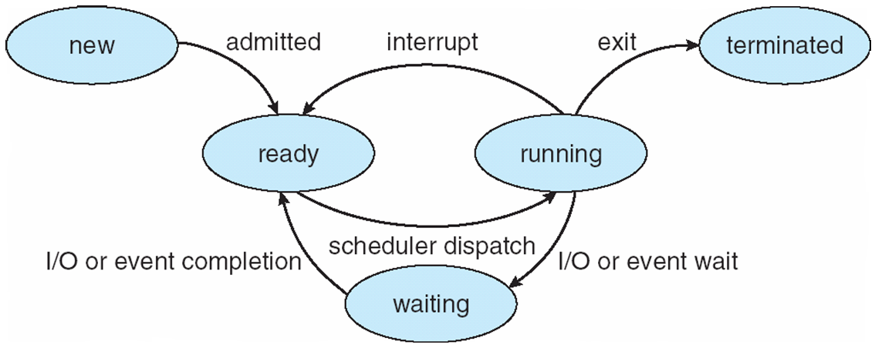
Diagram of Process State

Slide 11
Process Elements
A process is comprised of:
Program code (possibly shared)
A set of data
A number of attributes describing the state of the process

Slide 12
Process Elements
While the process is running it has a number of elements including
Identifier
State
Priority
Program counter
Memory pointers
Context data
I/O status information
Accounting information

Slide 13
Process Control Block (PCB)
A Process Control Block is a data structure maintained by the Operating System for every process. The PCB is identified by an integer process ID (PID). A PCB keeps all the information needed to keep track of a process as listed below in the table
The architecture of a PCB is completely dependent on Operating System and may contain different information in different operating systems.
The PCB is maintained for a process throughout its lifetime, and is deleted once the process terminates.

Slide 14
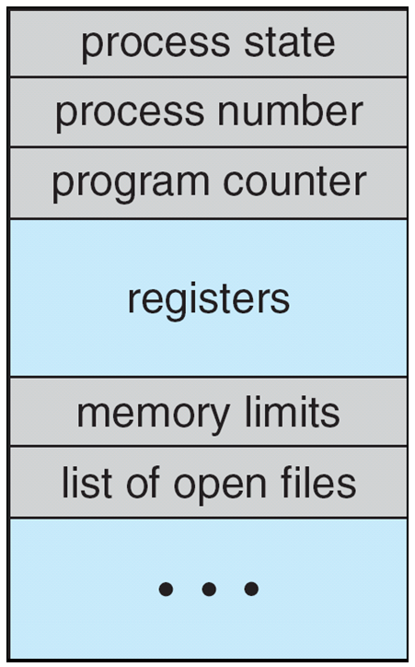
Process Control Block (PCB)
Information associated with each process
(also called task control block)
Process state – state may be new, running, waiting, etc
Program counter – location of instruction to next execute
CPU registers – contents of all process-centric registers
CPU scheduling information- priorities, scheduling queue pointers
Memory-management information – memory allocated to the process
Accounting information – CPU used, clock time elapsed since start, time limits
I/O status information – I/O devices allocated to process, list of open files

Slide 15
S.N. | Information & Description
1 | Process State The current state of the process i.e., whether it is ready, running, waiting, or whatever.
2 | Process privileges This is required to allow/disallow access to system resources.
3 | Process ID Unique identification for each of the process in the operating system.
4 | Pointer A pointer to parent process.
5 | Program Counter Program Counter is a pointer to the address of the next instruction to be executed for this process.
6 | CPU registers Various CPU registers where process need to be stored for execution for running state.
7 | CPU Scheduling Information Process priority and other scheduling information which is required to schedule the process.
8 | Memory management information This includes the information of page table, memory limits, Segment table depending on memory used by the operating system.
9 | Accounting information This includes the amount of CPU used for process execution, time limits, execution ID etc.
10 | IO status information This includes a list of I/O devices allocated to the process.

Slide 16
Process Scheduling
Maximize CPU use, quickly switch processes onto CPU for time sharing(so that user can interact with each program while its running.
Process scheduler selects among available processes for next execution on CPU
Maintains scheduling queues of processes
Job queue – set of all processes in the system
Ready queue – set of all processes residing in main memory, ready and waiting to execute
Device queues – set of processes waiting for an I/O device
Processes migrate among the various queues

Slide 17
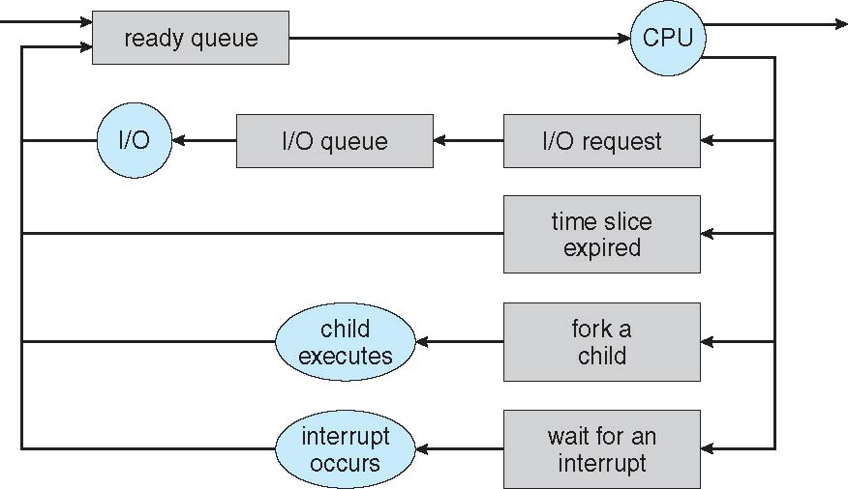
Representation of Process Scheduling
Queueing diagram represents queues, resources, flows

Slide 18
Schedulers
A process migrate among various scheduling queries throughout its lifetime . The OS must select for scheduling purposes , process for these queries in some fashion . The selection process is carried out by the appropriate schedule .

Slide 19
Schedulers
Short-term scheduler (or CPU scheduler) – selects which process should be executed next and allocates CPU
Sometimes the only scheduler in a system
Short-term scheduler is invoked frequently (milliseconds) ⇒ (must be fast)
Long-term scheduler (or job scheduler) – selects which processes should be brought into the ready queue
Long-term scheduler is invoked infrequently (seconds, minutes) ⇒ (may be slow)
Processes can be described as either:
I/O-bound process – spends more time doing I/O than computations
CPU-bound process – spends more time doing computations

Slide 20
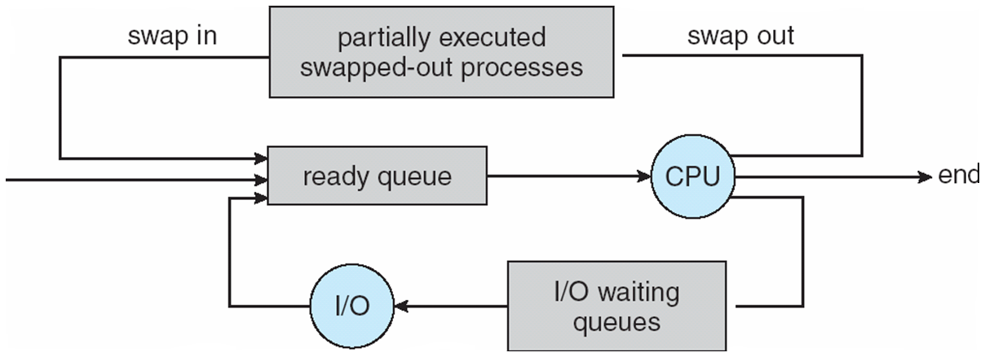
Addition of Medium Term Scheduling
Medium-term scheduler can be added if degree of multiple programming needs to decrease
Remove process from memory, store on disk, bring back in from disk to continue execution: swapping

Slide 21
Context Switch
When CPU switches to another process, the system must save the state of the old process and load the saved state for the new process via a context switch
Kernel save the content of old process in PCB and load the saved context of the new process scheduled to run
Context of a process represented in the PCB
Context-switch time is overhead; the system does no useful work while switching
The more complex the OS and the PCB ➔ the longer the context switch
Time dependent on hardware support
Some hardware provides multiple sets of registers per CPU ➔ multiple contexts loaded at once

Slide 22
Operations on Processes
System must provide mechanisms for:
process creation,
process termination,

Slide 23
Process Creation
During the course of execution a (process) Parent process create children processes, which, in turn create other processes, forming a tree of processes
Generally, process identified and managed via a process identifier (pid)
Resource sharing options
Parent and children share all resources
Children share subset of parent’s resources
Parent and child share no resources
Execution options
Parent and children execute concurrently
Parent waits until children terminate

Slide 24
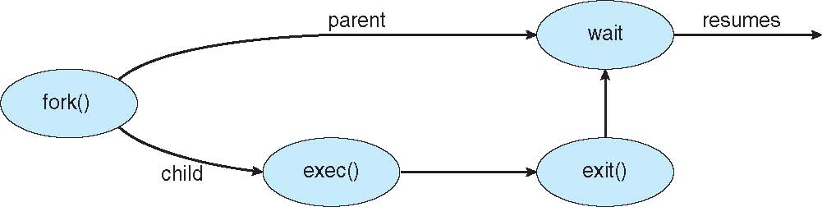
Process Creation (Cont.)
Address space
Child duplicate of parent
Child has a program loaded into it
UNIX examples
fork() system call creates new process
exec() system call used after a fork() to replace the process’ memory space with a new program

Slide 25
Process Termination
Process executes last statement and then asks the operating system to delete it using the exit() system call.
Returns status data from child to parent (via wait())
Process’ resources are deallocated by operating system
Parent may terminate the execution of children processes using the abort() system call. Some reasons for doing so:
Child has exceeded allocated resources
Task assigned to child is no longer required
The parent is exiting and the operating systems does not allow a child to continue if its parent terminates

Slide 26
Process Termination
Some operating systems do not allow child to exists if its parent has terminated. If a process terminates, then all its children must also be terminated.
cascading termination. All children, grandchildren, etc. are terminated.
The termination is initiated by the operating system.
The parent process may wait for termination of a child process by using the wait()system call. The call returns status information and the pid of the terminated process
pid = wait(&status);
If no parent waiting (did not invoke wait()) process is a zombie
If parent terminated without invoking wait , process is an orphan

Slide 27
Interprocess Communication
Processes within a system may be independent or cooperating
An independent process is not affected by the execution of other processes while a co-operating process can be affected by other executing processes. Cooperating process can affect or be affected by other processes, including sharing data
Reasons for cooperating processes:
Information sharing
Computation speedup
Modularity
Convenience
Inter process communication (IPC) is a mechanism which allows processes to communicate each other and synchronize their actions. The communication between these processes can be seen as a method of co-operation between them
Cooperating processes need interprocess communication (IPC)
Two models of IPC
1.Shared memory 2. Message passing

Slide 28
Communications Models
(a) Message passing. (b) shared memory

Slide 29
Interprocess Communication – Shared Memory
Communication between processes using shared memory requires processes to share some variable and it completely depends on how programmer will implement it. One way of communication using shared memory can be imagined like this: Suppose process1 and process2 are executing simultaneously and they share some resources or use some information from other process, process1 generate information about certain computations or resources being used and keeps it as a record in shared memory. When process2 need to use the shared information, it will check in the record stored in shared memory and take note of the information generated by process1 and act accordingly. Processes can use shared memory for extracting information as a record from other process as well as for delivering any specific information to other process.

Slide 30
Interprocess Communication – Message Passing
In this method, processes communicate with each other without using any kind of shared memory. If two processes p1 and p2 want to communicate with each other, they proceed as follow:
Establish a communication link (if a link already exists, no need to establish it again.)
Start exchanging messages using basic primitives. We need at least two primitives: – send(message, destination) or send(message) – receive(message, host) or receive(message)

Slide 31
The message size can be of fixed size or of variable size. if it is of fixed size, it is easy for OS designer but complicated for programmer and if it is of variable size then it is easy for programmer but complicated for the OS designer. A standard message can have two parts: header and body. The header part is used for storing Message type, destination id, source id, message length and control information. The control information contains information like what to do if runs out of buffer space, sequence number, priority. Generally, message is sent using FIFO style.

Slide 32
Message Passing (Cont.)
If processes P and Q wish to communicate, they need to:
Establish a communication link between them
Exchange messages via send/receive
Implementation issues:
How are links established?
Can a link be associated with more than two processes?
How many links can there be between every pair of communicating processes?
What is the capacity of a link?
Is the size of a message that the link can accommodate fixed or variable?
Is a link unidirectional or bi-directional?

Slide 33
A link has some capacity that determines the number of messages that can reside in it temporarily for which Every link has a queue associated with it which can be either of zero capacity or of bounded capacity or of unbounded capacity. In zero capacity, sender wait until receiver inform sender that it has received the message. In non-zero capacity cases, a process does not know whether a message has been received or not after the send operation. For this, the sender must communicate to receiver explicitly. Implementation of the link depends on the situation, it can be either a Direct communication link or an In-directed communication link. Direct Communication links Each process that wants to communicate must explicitly name the recipient or sender of the communication.
In-directed Communication is done via a shred mailbox (port), which consists of queue of messages. A mailbox can be viewed abstractly as an object into which messages can be placed by processes and from which messages can be removed. Sender keeps the message in mailbox and receiver picks them up.

Slide 34
Direct Communication
Processes must name each other explicitly:
send (P, message) – send a message to process P
receive(Q, message) – receive a message from process Q
Properties of communication link
Links are established automatically
A link is associated with exactly one pair of communicating processes
Between each pair there exists exactly one link
The link may be unidirectional, but is usually bi-directional

Slide 35
Indirect Communication
Messages are directed and received from mailboxes (also referred to as ports)
Each mailbox has a unique id
Processes can communicate only if they share a mailbox
Properties of communication link
Link established only if processes share a common mailbox
A link may be associated with many processes
Each pair of processes may share several communication links
Link may be unidirectional or bi-directional

Slide 36
Indirect Communication
Operations
create a new mailbox (port)
send and receive messages through mailbox
destroy a mailbox
Primitives are defined as:
send(A, message) – send a message to mailbox A
receive(A, message) – receive a message from mailbox A

